Slide 1
Cybersecurity internship encryption of image using triple des
By Sheefa Jalali

Slide 2
abstract
In today’s world almost all digital services like internet communication, medical and military imaging systems, multimedia system needs a high level and Protected security.
There is a need for security level in order to safely store and transmit digital images containing critical information
Therefore, there is a need for image encryption techniques in order to hide images from such attacks.
In this system we use Triple DES (Data Encryption Standard) in order to hide image. Such Encryption technique helps to avoid Active and Passive Attacks.

Slide 3
Table of contents
Introduction
Existing Method
Proposed method with Architecture
Methodology
Implementation
Conclusion

Slide 4
introduction
In this era of universal electronic connectivity, the possibility of data damage or stolen is extremely high that is why it is needs time is to secure data from those groups. The tremendous growth in computer systems and interconnection with networks have increased depending on company or individual based on information stored and communicated using this system. There is a need to protect the data from disclosure and to protect systems from network-based attacks. Cryptography is a technique which is intended to transform the data and can be used to supply various security related concepts such as confidentiality, data integrity, authentication, authorization, and non-repudiation. Secure the information and other services is important thing by using the security mechanism we must protected from unintended or unauthorized access, change or destruction.
Encryption/decryption are the fundamental function of cryptography, which is used to hide the information from the unauthorized users so that chances of threats also reduced. The aim of many cryptosystems is to make their data computationally infeasible to crack by intruders.

Slide 5
Existing Method
Double DES is an encryption technique which uses two instance of DES on same plain text. In both instances it uses different keys to encrypt the plain text. Both keys are required at the time of decryption. The 64-bit plain text goes into first DES instance which then converted into a 64-bit middle text using the first key and then it goes to second DES instance which gives 64-bit cipher text by using second key.
Has two encryption stages and two keys
Given a plaintext P and two encryption keys K1 and K2 and , ciphertext C is generated as C = E(K2, E(K1, P))
Decryption requires that the keys be applied in reverse order P = D(K1, D(K2, C))
This scheme apparently involves a key length of 56 * 2 = 112 bits, resulting in a dramatic increase in cryptographic strength

Slide 6
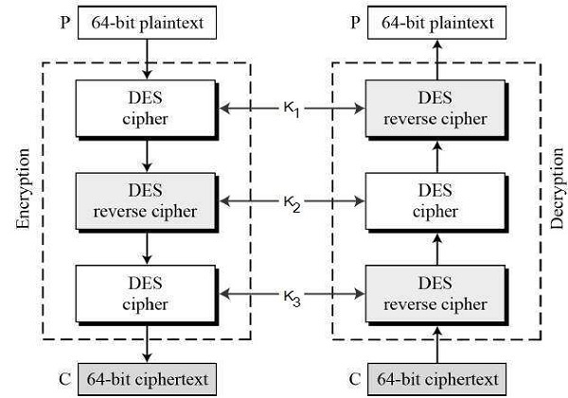
architecture

Slide 7
Proposed method
An enhancement of DES and Double DES, the 3DES (Triple DES) encryption standard was proposed. In this standard the encryption method is like the one in original DES but applied 3 times to increase the encryption level. Triple DES systems are significantly more secure than single DES, but these are clearly a much slower process than encryption using single DES.

Slide 8
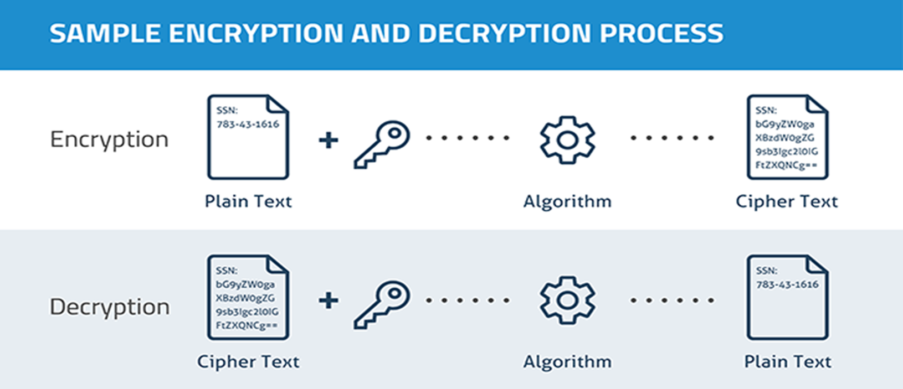
Methodology

Slide 9
Triple des encryption
In cryptography, Triple DES, officially the Triple Data Encryption Algorithm, is a symmetric-key block cipher, which applies the DES cipher algorithm three times to each data block.
Block sizes: 64 bits Key sizes: 168, 112 or 56 bits (keying option 1, 2, 3 respectively)
Triple DES is an encryption technique which uses three instance of DES on same plain text.
It uses their different types of key choosing technique in first all used keys are different and in second two keys are same and one is different and in third all keys are same.

Slide 10
Triple des algorithm
TDES has a fixed data block size of 8 bytes. It consists of the cascade of 3 Single DES ciphers (EDE: Encryption - Decryption - Encryption), where each stage uses an independent DES sub-key.
The standard defines 2 Keying Options:
Option 1: all sub-keys take different values (parity bits ignored). The TDES key is therefore 24 bytes long (concatenation of K1, K2, and K3) , to achieve 112 bits of effective security.
Option 2: K1 matches K3 but K2 is different (parity bits ignored). The TDES key is 16 bytes long(concatenation of K1 and K2), to achieve 90 bits of effective security. In this mode, the cipher is also termed 2TDES.

Slide 11
implementation
Encrypt the plaintext blocks using single DES with key K1.
Now decrypt the output of step 1 using single DES with key K2.
Finally, encrypt the output of step 2 using single DES with key K3.
The output of step 3 is the ciphertext.
Decryption of a ciphertext is a reverse process

Slide 12
conclusion
Triple DES algorithm to encrypt and decrypt the data. This supplies a better process of secure encryption and decryption. It is more secure and faster than double DES. As it has lengthy key chances of attacking the data is less. So, it supplies security in the storage and transmission of data.

Slide 13
Thank you

